Slide 1
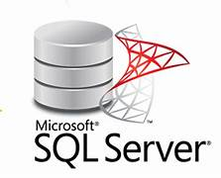
Microsoft SQL Server
Data Science in Tamil(DSIT)
“Introduction to MSSQL Server: Learn to Speak Data”
Disclaimer : “Microsoft and SQL Server are trademarks of Microsoft Corporation. This presentation is for educational purposes only.”

Slide 2
Types of Databases : Relational vs Non-Relational
Relational databases are ideal for applications where data integrity, which refers to the accuracy and consistency of data stored in a database, is non-negotiable — such as financial systems, inventory management, and enterprise resource planning (ERP) systems.
Popular Relational Databases
MySQL: The world’s most popular open-source RDBMS.
PostgreSQL: An advanced open-source object-relational database.
Microsoft SQL Server: A robust commercial database often used in large enterprises.
IBM Db2: A commercial solution widely adopted by large businesses.
SQLite: A lightweight, serverless database embedded in many mobile and desktop applications.
Use a Relational Database if:
You need complex transactions and joins.
Your data has a well-defined structure.
ACID compliance is critical (e.g., financial systems).

Slide 3
Types of Databases : Relational vs Non-Relational
Non-Relational Databases (NoSQL): Flexible and Scalable
Unlike relational databases, non-relational (NoSQL) databases store data without a rigid table-based structure. They offer flexibility by supporting varied formats, such as JSON documents, key-value pairs, graphs, or column families.
Non-relational databases shine when working with large-scale, dynamic, or unstructured data — such as user activity logs, social media feeds, IoT sensor data, and multimedia content.
They are designed for high-speed, horizontally scalable operations — and often prioritize availability and partition tolerance over strict consistency.
Need for non-relational databases
Non-relational databases, or NoSQL databases, store and manage large-scale data. They are especially useful for managing unstructured data, such as texts or images. You can also use them to store frequently accessed data, like user activity logs.

Slide 4
Types of Databases : Relational vs Non-Relational
Non-relational databases are designed to handle large-scale data more efficiently than traditional relational databases. Companies with large datasets, such as social media networks and online retailers, often use them.
Popular non-relational databases
The most popular non-relational databases are MongoDB, Cassandra, and HBase. Companies like Facebook, Twitter, and LinkedIn use these databases. They offer features not available in traditional relational databases, such as the ability to handle large-scale data and the flexibility to add and remove data.
Use a NoSQL database if:
You are working with data that is rapidly changing and unstructured.
You need massive horizontal scalability.
Schema flexibility is a priority.

Slide 5
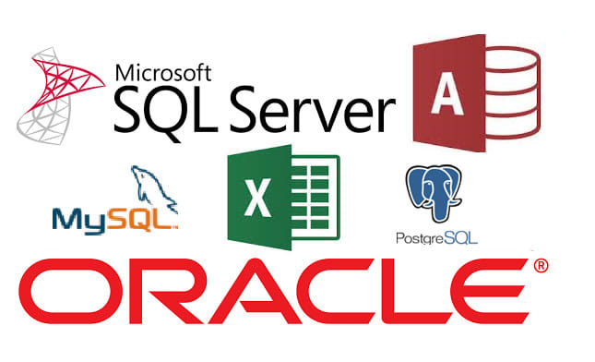
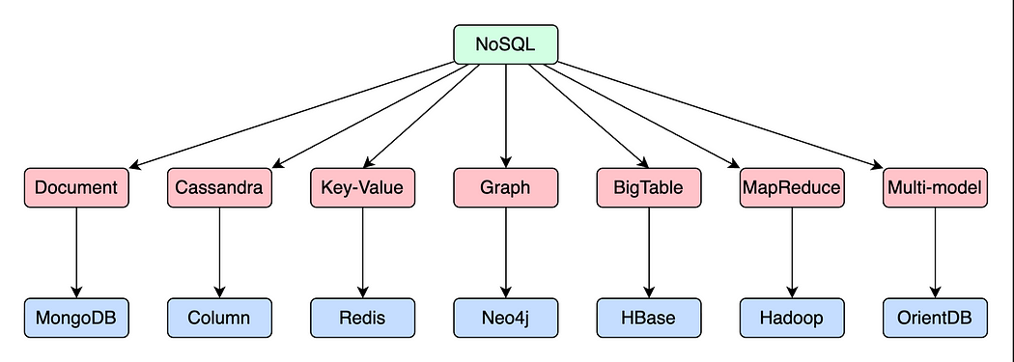
Types of Databases : Relational vs Non-Relational

Slide 6

SQL vs NoSQL
SQL | NoSQL
Like Excel : Data in Rows and Columns | Like Sticky Notes : Flexible Format
Perfect for Banking and Shopping | Great for Social Media and Games
Fixed Structure like a table | Free-style data storage
SQL
Complex Relationships
Perfect when your data is interconnected
NoSQL
Flexible Data Structure
Great for changing data formats
SQL
Data Consistency
Banking and Financial Applications
NoSQL
Fast Performance
Quick Read and Writes
SQL
Complex Queries
Reporting and Analytics

Slide 7
Types of Databases : Relational vs Non - Relational Database
Property | Relational Database | Non-Relation Database
Data Structure | Structured data in tables with fixed schemas | Flexible, semi-structured or unstructured data.
Schema | Predefined Schema with strict data types. | Schema-less or dynamic schema with varying data types.
Scalability | Scales Vertically(Upward) with more powerful hardware. | Scales Horizontally(Outward) with distributed systems.
Query Language | SQL(Structured Query Language) for complex queries. | Query languages vary per database type.(e.g, MongoDB uses JSON file queries)
Transactions | Supports ACID transactions for data consistency. | Often provides eventual consistency, relaxed transaction support.
Scaling Challenges | Face challenges when scaling due to rigid schemas. | Well-suited for handling large-scale and dynamic data.
Use Cases | Complex, Structured data. | Ideal for unstructured or semi-structured data.
Examples | MySQL, MSSQL, PostgreSQL, Oracle | MongoDB, Cassandra, Redis, Elastic Search

Slide 8
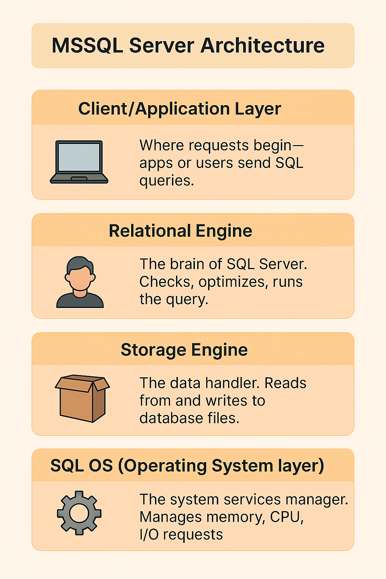
4. Microsoft SQL Server Architecture
1.Client/Application Layer
🧑‍💻 What it is: Where requests begin—apps or users send SQL queries.
📬 Role: Sends instructions like “Get all employees” or “Update salary.”
2. Relational Engine
🧠 What it is: The brain of SQL Server.
🔍 Role:
Parser checks the query syntax.
Optimizer finds the best way to execute it.
Executor runs the query and gets the result.

Slide 9
Microsoft SQL Server Architecture
3.Storage Engine
🧑‍💻 What it is: The data handler.
📬 Role:
Reads from and writes to the physical database files (.mdf/.ldf).
Manages indexes, pages, and locking to handle data efficiently.
4. SQL OS(Operating System Layer)
🧠 What it is: The system services manager.
🔍 Role:
Manages memory, CPU scheduling, I/O requests.
Keeps things running smoothly behind the scenes.

Slide 10
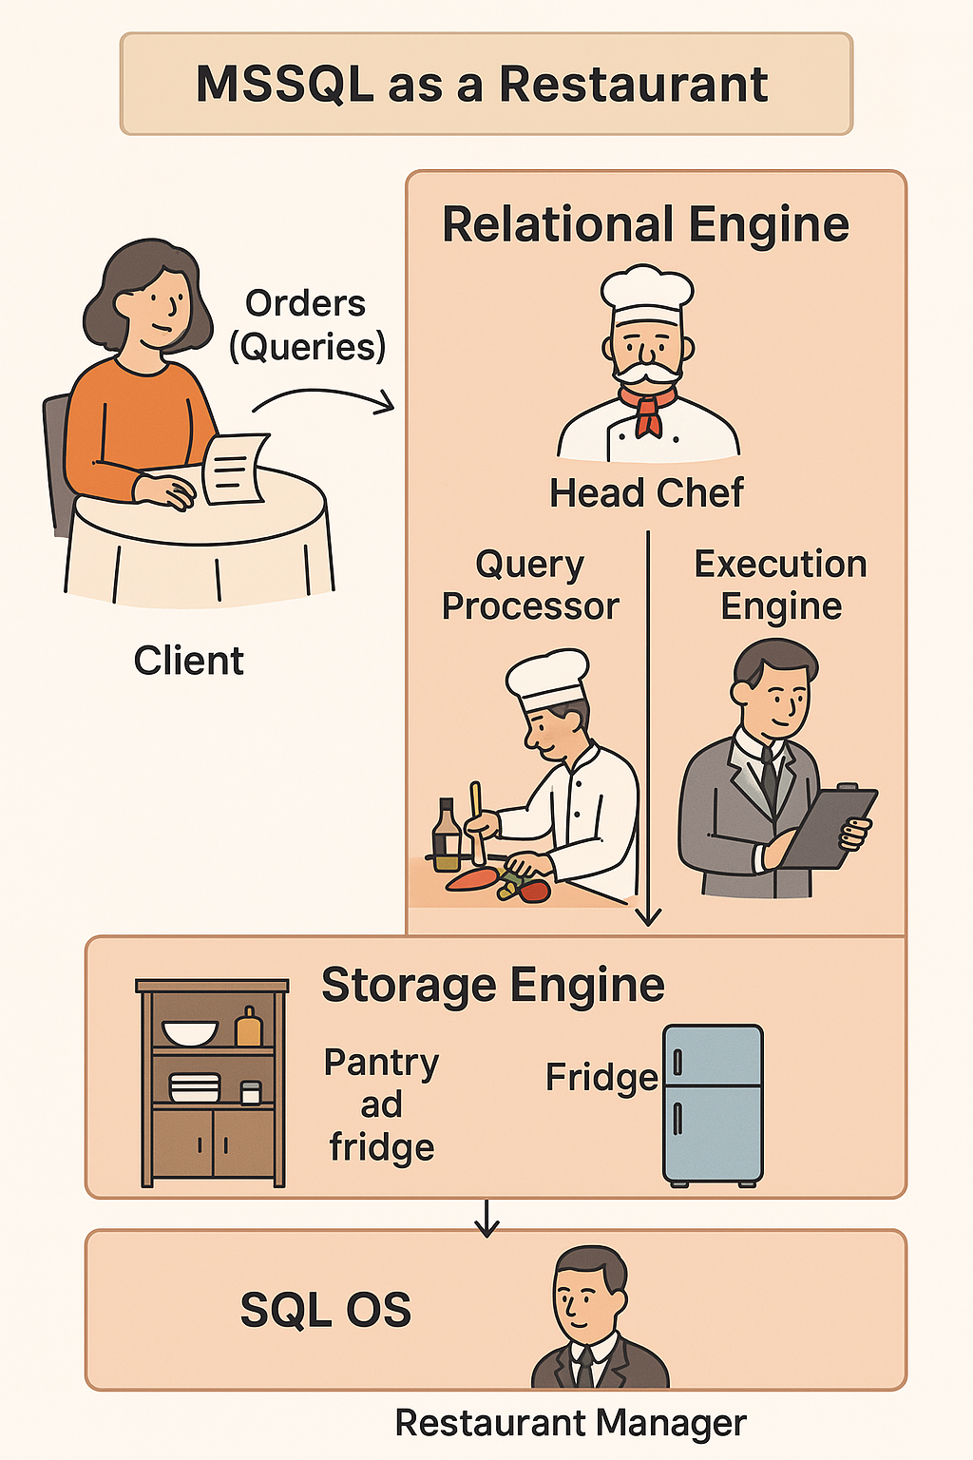
Microsoft SQL Server Architecture
You (customer) place an order (query).
The chef (Relational Engine) reviews the order and decides how best to prepare it.
The pantry (Storage Engine) provides the ingredients (data).
The manager (SQL OS) ensures there's enough power and resources to keep things smooth.
Your delicious dish (query result) comes back to you.

Slide 11
5. Introduction to Microsoft SQL Server(MSSQL)
What Is SQL Server?
It is a software, developed by Microsoft, which is implemented from the specification of RDBMS.
It is platform dependent. SQL Server ran only on Windows for many years, making it a Windows-dependent platform. Microsoft began supporting Linux (for distributions like Ubuntu, Red Hat, SUSE), making SQL Server cross-platform starting with version 2017.
SQL Server 2019, 2022, and likely 2025 all continue to support Linux, in addition to Windows.
macOS – Not natively supported means that an application or software doesn’t run directly on that platform or operating system—at least not without extra tools or workarounds. Need to use Docker, a virtual machine (VM), or remote access to a server that’s running SQL Server.
To create databases.
To maintain databases.
To analyze the data through SQL Server Analysis Services (SSAS).
To generate reports through SQL Server Reporting Services (SSRS).
To carry out ETL operations through SQL Server Integration Services (SSIS).

Slide 12

Introduction to Microsoft SQL Server(MSSQL)
Core Components of SQL Server
First Steps
Install SQL Server Express and SSMS.
Create your first database.
Write a simple SELECT Query
Tools Used
SQL Server Express (Free edition for learning)
SQL Server Management Studio (SSMS) – IDE for writing and running queries
SELECT
SERVERPROPERTY('Edition') AS Edition,
SERVERPROPERTY('ProductVersion') AS ProductVersion

Slide 13
MSSQL Server Edition – Comparison Table

Slide 14
MSSQL Server Installation Guide
What Is SQL Server Express?
1. Free edition of Microsoft SQL Server
2. Ideal for students, developers, and small-scale apps
3. Lightweight, easy to install, and supports core database features
Step 1 – Download the Installer
Go to the official site: https://aka.ms/sqlexpress
Click Download now
Choose the Basic installer for quick setup or Custom for advanced options
Step 2 – Launch the Installer
Run the downloaded .exe file
Choose one of the following:
Basic – Quick install with default settings
Custom – Choose features and install location
Download Media – Save installer for offline use

Slide 15
MSSQL Server Installation Guide
Step 3 – Installation Process
Accept license terms
Choose install location (optional)
Click Install
Wait for the installation to complete (takes a few minutes)
Step 4 – Install SQL Server Management Studio (SSMS)
SSMS is the GUI tool to manage SQL Server
Download from: https://aka.ms/ssms
Install and launch SSMS
Connect to your server using:
Server name: .(dot) or .\YourInstanceName
Authentication: Windows Authentication
Getting MSSQL Server Instance Name
SELECT SERVERPROPERTY('InstanceName') AS InstanceName;
If it returns NULL, you're using the default instance (connect using just . or localhost).
If it returns a name like SQLEXPRESS, then your instance name is .\SQLEXPRESS.

Slide 16
6. Understanding .mdf and .ldf in MSSQL Server
.mdf – Main Data File
Primary data file in a SQL Server database.
It contains database objects such as tables, indexes and stored procedures and other objects.
Must have at least one .mdf file.
When you create a database .mdf file is created automatically.
By default, SQL Server stores .mdf files in predefined folder, but you can specify the location
when creating a new database using “CREATE DATABASE” command.
.ldf – Log Data File
In Microsoft SQL Server, the .ldf file is the Log Data File.
.ldf files stores transaction logs, which are used for database recovery.
Transaction log in the .ldf file ensure the ACID(Atomicity, Consistency, Isolation and Durability properties of the database. Even if the SQL Server crashes, the logs allow it to bring the database back to a consistent state by replaying committed transactions or rolling back incomplete ones.
These logs contains a detailed log of every transaction that modifies the database. This includes
DML( INSERT, UPDATE, DELETE ) and DDL (ALTER, DROP etc.) Commands.

Slide 17
Creating Database
CREATE DATABASE DSIT_DB_TEST
ON
PRIMARY (
NAME = 'DSIT_DB_TEST_DATA',
FILENAME = 'F:\Database\DSIT_DB_TEST.mdf',
SIZE = 10MB,
MAXSIZE = 1000MB,
FILEGROWTH = 5MB
)
LOG ON (
NAME = 'DSIT_DB_TEST_LOG',
FILENAME = 'F:\Database\DSIT_DB_TEST.ldf',
SIZE = 5MB,
MAXSIZE = 500MB,
FILEGROWTH = 5MB
);

Slide 18
Database Parameters
Getting Data File Location
SELECT name AS LogicalName, physical_name AS FilePath,
type_desc AS FileType FROM sys.master_files
WHERE database_id = DB_ID('DSIT_DB');

Slide 19
System Databases in MSSQL Server
1. master
Stores info about the entire SQL Server instance — including logins, system configuration, linked servers, and locations of other databases.
The “brain” of SQL Server.
Always back up master after changes to logins, linked servers, or configuration.
Avoid creating user objects in master—they’ll be lost if the database is rebuilt.
You can’t drop, rename, or set master offline—it’s protected for good reason.
USE master;
GO
-- View all databases
SELECT name, database_id, state_desc FROM sys.databases;
-- View all logins
SELECT name, type_desc FROM sys.server_principals;
-- View linked servers
SELECT name FROM sys.servers WHERE is_linked = 1;
-- View configuration settings
EXEC sp_configure;

Slide 20
System Databases in MSSQL Server
2. msdb
The msdb database is SQL Server’s task manager and scheduler. It stores metadata for:
SQL Server Agent jobs (schedules, steps, history).
Backup and restore history.
Database Mail (profiles, logs, attachments).
Service Broker (messaging between components).
SSIS packages (if stored in SQL Server).
Maintenance plans, alerts, and operators.
USE msdb;
GO
-- View all Agent jobs
SELECT name, enabled FROM dbo.sysjobs;
-- View backup history
SELECT TOP 10 * FROM dbo.backupset ORDER BY backup_finish_date DESC;
-- View Database Mail profiles
SELECT * FROM dbo.sysmail_profile;
-- View SSIS packages (if stored here)
SELECT * FROM dbo.sysssispackages;

Slide 21
System Databases in MSSQL Server
3. model
The model database in SQL Server is like a template for all new databases created on the instance.
Any tables, views, or procedures you add manually will be copied to new DBs.
⚠️ If you create a table in model, it will appear in every new database you create—including tempdb on restart!.
Cannot be dropped, renamed, or set offline.
Cannot enable Change Data Capture (CDC).
Cannot participate in database mirroring.
Backup model after any changes.

Slide 22
System Databases in MSSQL Server
4. tempdb
A global, shared workspace used by all users and sessions.
Recreated fresh every time SQL Server restarts—no persistent data.
Recreated on every SQL Server restart—starts clean.
Based on model database—any object in model gets copied into tempdb.
# – Local Temporary Table
Visible only to the current session/connection
Automatically deleted when the session ends
# – Global Temporary Table
Visible to all sessions on the server
Deleted only when the creating session ends and no other session is using it.

Slide 23
7. Creating and Altering Database Objects
In SQL Server, database objects are the building blocks of a database. They are used to store data, organize it, secure it, and run logic or automate tasks.
Schemas - A logical container for grouping database objects (like folders).
Tables - The core structure in any database. Stores data in rows and columns (like Excel).
Views - A virtual table based on a SQL query. Simplify complex queries. Restrict sensitive columns
Stored Procedures - A pre-written, stored set of SQL statements you can call when needed.
Functions - Similar to stored procedures, but they must return a value.
Triggers - A special kind of stored procedure that runs automatically when a specific change (INSERT, UPDATE, DELETE) is made to a table.
Indexes - Like an index in a book, it helps SQL Server find data faster.
Constraints - Rules to ensure data accuracy and integrity in tables.(Primary Key, Foreign Key, Unique, NOT NULL, CHECK)
Users and Roles - Define who can access the database and what they can do.
Sequences - Generates incrementing numbers used for things like invoice numbers or IDs.

Slide 24
Creating and Altering Database Objects
Fetching All Objects in Current Database
SELECT
o.name AS ObjectName,
o.type ObjectType,
o.type_desc AS ObjectDescription,
s.name AS SchemaName
FROM
sys.objects o
JOIN
sys.schemas s ON o.schema_id = s.schema_id
ORDER BY
ObjectType, SchemaName, ObjectName;
To check your current default database:
SELECT name, default_database_name
FROM sys.server_principals
WHERE name = Domain\LOGANATHAN';

Slide 25
Creating and Altering Database Objects
How to change default database
Option 1: Change via SSMS (SQL Server Management Studio)
Open SSMS and connect to your server.
In Object Explorer, go to: Security → Logins
Find your login name (e.g., Loganathan) and right-click → Properties
In the General tab, look for Default database
Select your preferred database from the dropdown (e.g., StudentDB)
Click OK
Option 2: Change via SQL Command
ALTER LOGIN [login_name] WITH DEFAULT_DATABASE = [master]

Slide 26
📚 Schema Management in MSSQL Server

Slide 27
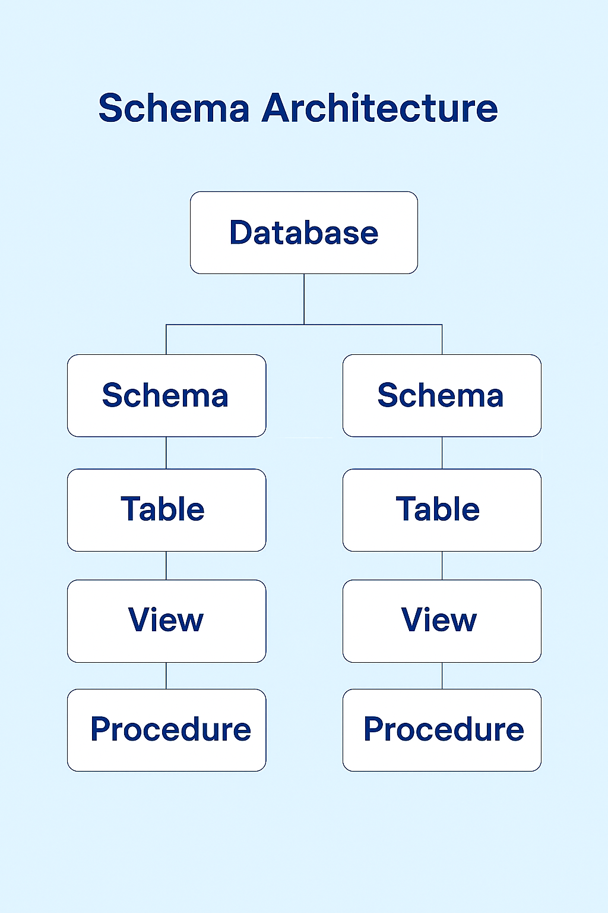
Table of Contents
Introduction to Schemas
Creating Schemas
Managing Schema Ownership
Designing Tables within Schemas
Transferring Objects Between Schemas
Understanding Permissions
Creating Logins and Users
Assigning Schema to Users
Auditing and User Listing

Slide 28
Creating Schema in MSSQL Server
What is Schema ?
A schema is a container for database objects.
Example: You can have DS.Employee and DS1.Employee—same table name, different schemas.
Use schemas to group related objects (e.g., Sales, Marketing, HR).
Assign permissions at the schema level for easier management.
Default schema is dbo (Database Owner).
If no schema is assigned while creating object then it's created under dbo schema.
Method 1: Using T-SQL
Basic Syntax: CREATE SCHEMA SchemaName
CREATE SCHEMA DS;
Creating Schema with Authorization
CREATE SCHEMA DS AUTHORIZATION dbo;

Slide 29
Creating Schema in MSSQL Server
Create the Employee Table Inside That Schema
CREATE TABLE DS.Employee (
EmployeeID INT PRIMARY KEY IDENTITY(1,1),
FirstName VARCHAR(50) NOT NULL,
LastName VARCHAR(50) NOT NULL,
Email VARCHAR(100) UNIQUE,
HireDate DATE NOT NULL,
DepartmentID INT,
CreatedDate DATETIME2 DEFAULT GETDATE()
);
Select * from DS.Employee

